Slide 1


Own the end-to-end homebuying experience.
Notes:
talk about who we are and our history in here (slide 2)

Slide 2


Slide 3
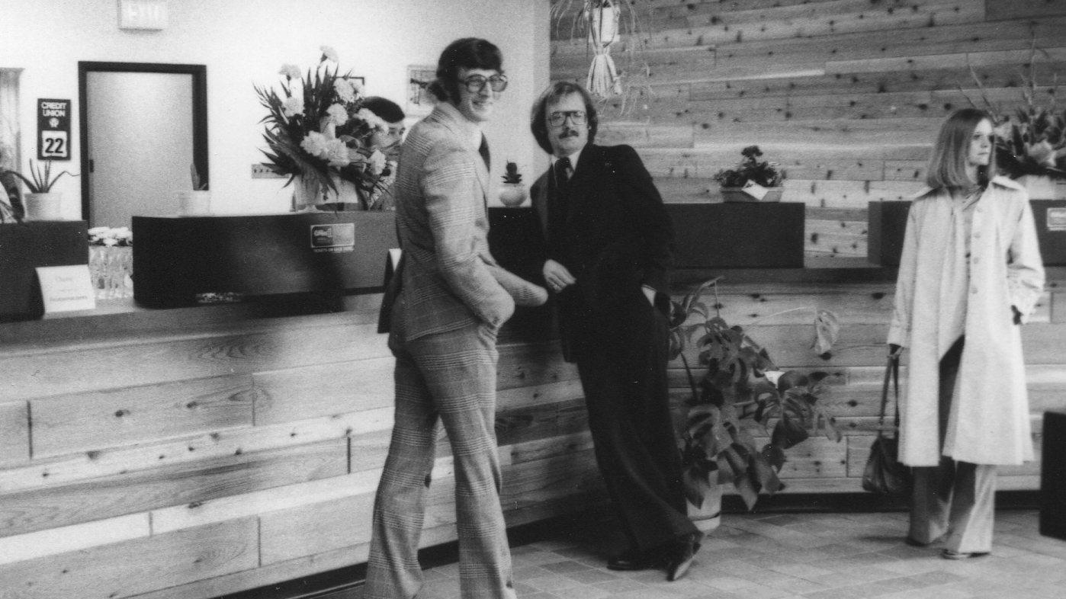

Slide 4

Millennials and the Mortgage Industry
85%
80%
71%
of homebuyers search for mortgage before looking for a home ¹
of real estate transactions
in the next 10 years
will be completed
by millennials ²
of millennials would rather visit their dentist than walk into a branch ²
Sources: ¹ LoanDepot Drive Research, 2017 ² The Millennial Disruption Index, 2013 https://www.bbva.com/wp-content/uploads/2015/08/millenials.pdf

Slide 5






Notes:
INDUSTRY SHIFT, airbnb , uber, etc

Slide 6


Convenience Economy
INTEGRATION
TRUST
DATA

Slide 7
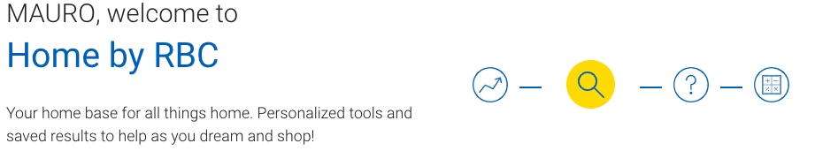
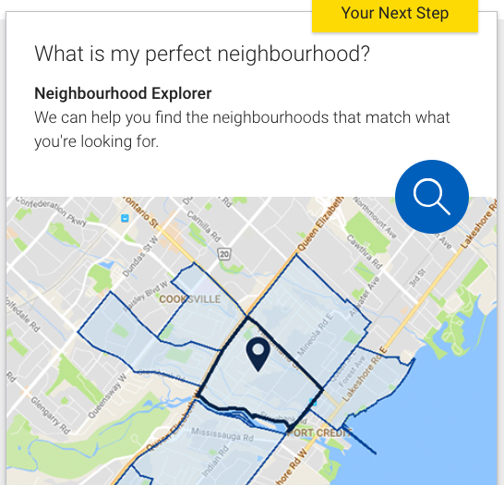
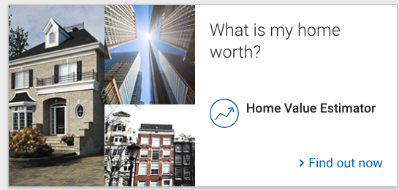
Notes:
INDUSTRY SHIFT

Slide 8
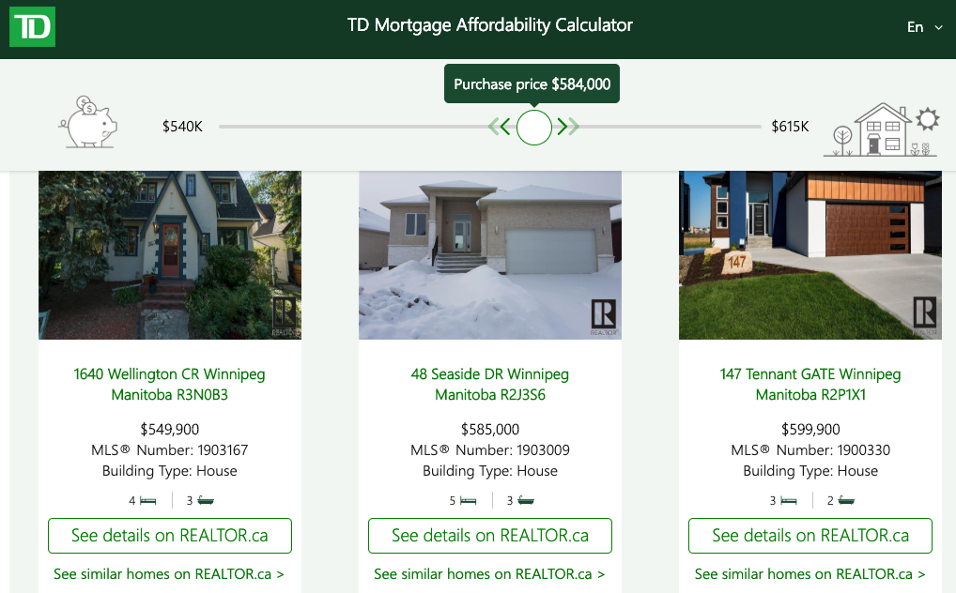
Notes:
INDUSTRY SHIFT

Slide 9











Be part of your member's life events
Retirement
Empty Nest
Promotion
Family
First Job
Graduation
Notes:
Life events timeline
graduate from school, renter
get first job, buy a condo
get married and have kids, buy the first home
get a promotion, buy a bigger house
kids growing up, move out, move back downtown
buy a beach home / cottage

Slide 10

AFFORDABILITY
CALCULATOR
EXPLORE
OPTIONS
CONTACT
REALTORS
SCHEDULE
VISITS
MAKE
OFFER
MORTGAGE
APPLICATION
TRACK HOME VALUE
Full Visibility
Data insights and higher conversions
Notes:
End-to-end home-buying solution allowing lenders to have full visibility on the entire process
With NestReady, you are able to have full visibility on the whole home buyer process of your client. And also, you'll have access to data insights on this journey that allows you to communicate timely better serve and convert your clients.
You can make your member feel supported by their financial institution along the entire home buying journey.

Slide 11
Total Home Ownership Experience
MONITOR YOUR PROPERTY
DISCOVER
Homebuyer Journey
CLOSE TRANSACTION
EXPLORE OPTIONS
PURCHASE PROPERTY

Slide 12
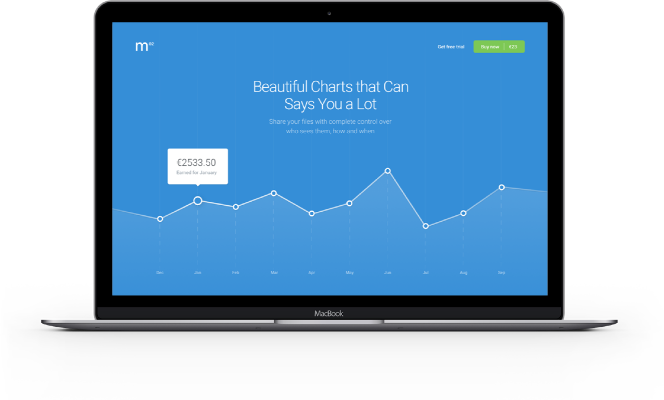
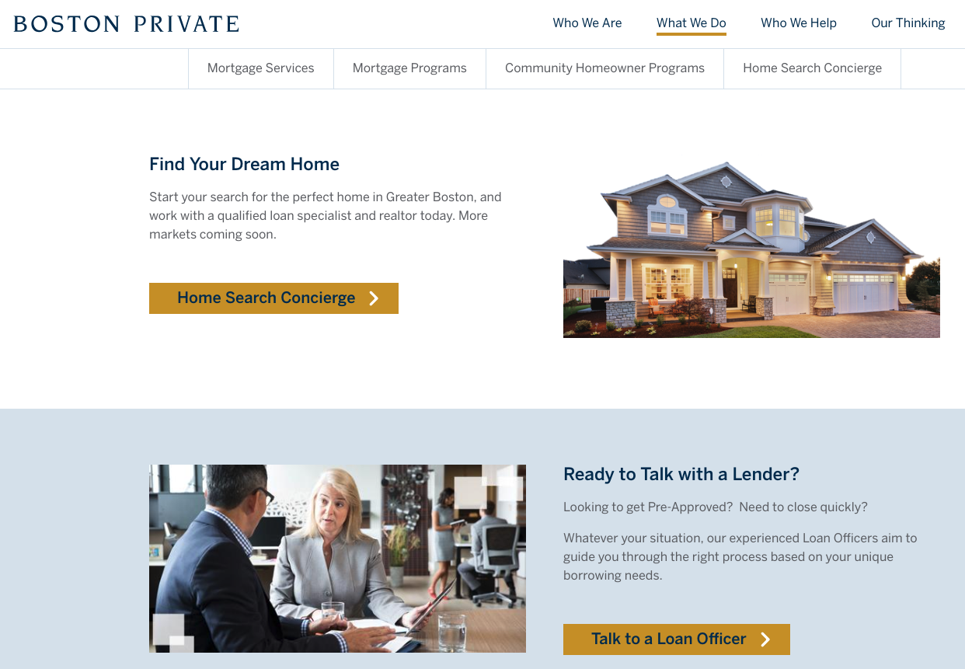

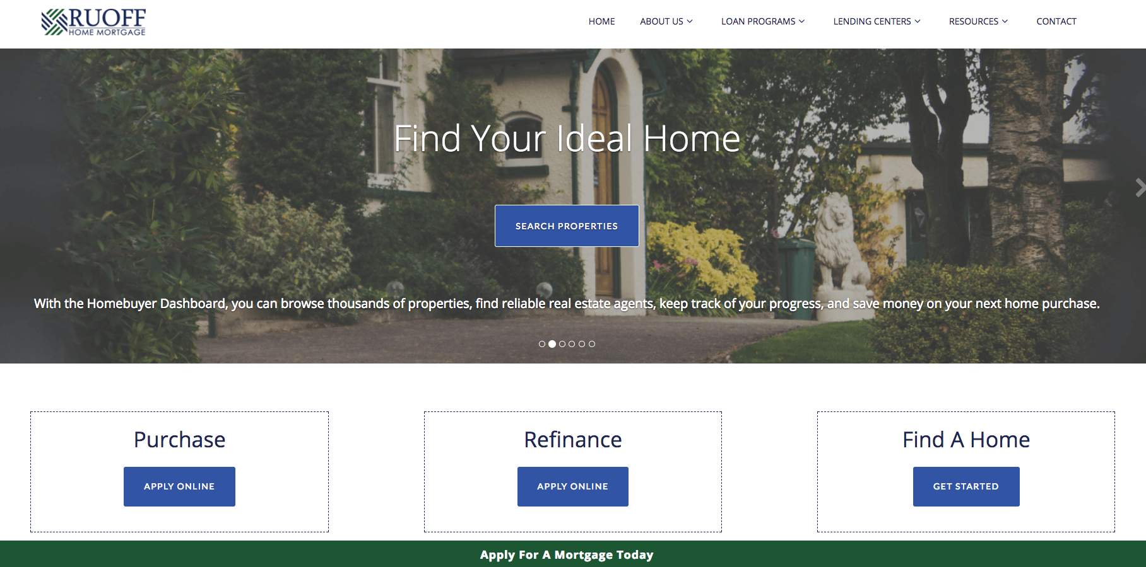
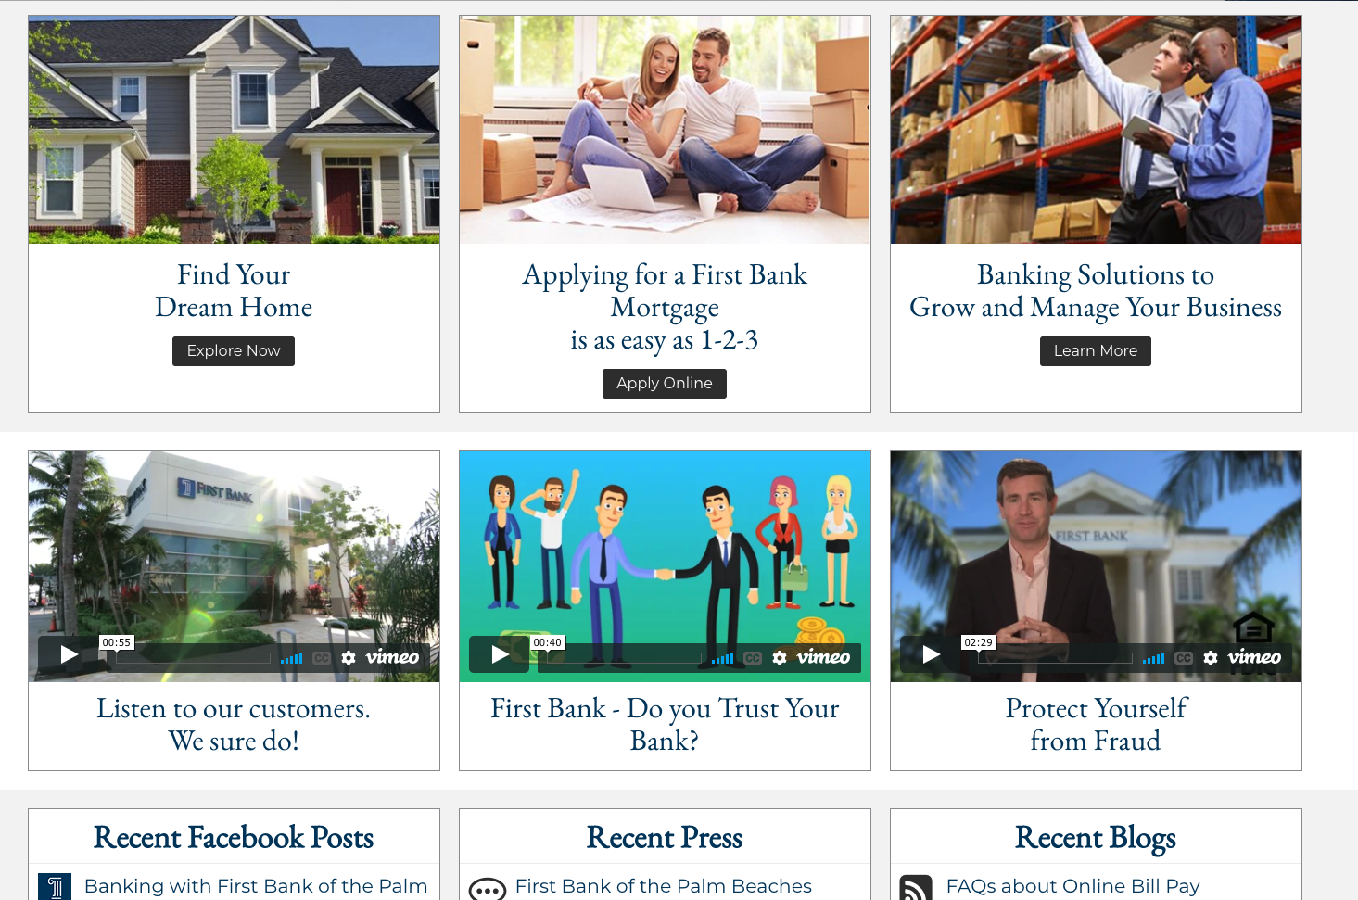
NestFinder
Plug & play solution combining every aspect of the home buying journey seamlessly integrated into the lender's website.

Slide 13
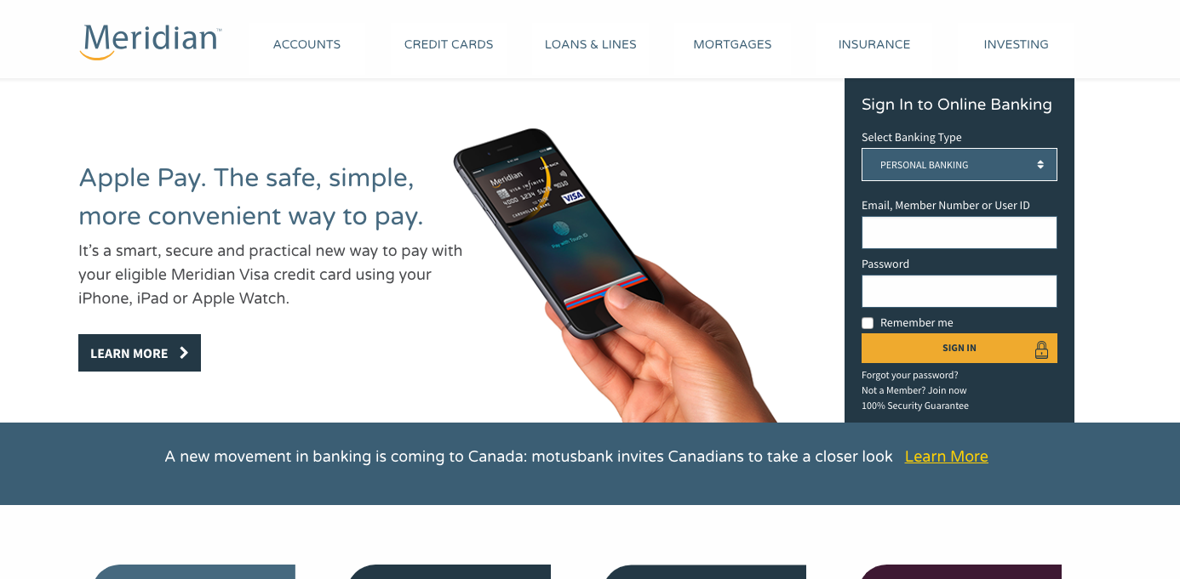
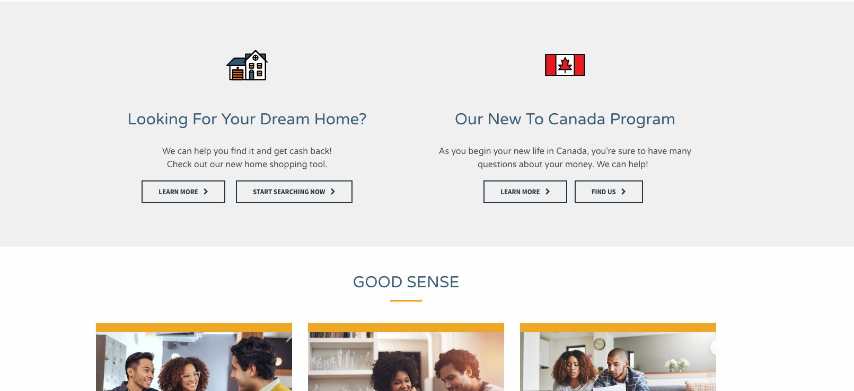
NestFinder
Plug & play solution combining every aspect of the home buying journey seamlessly integrated into the lender's website.

Slide 14
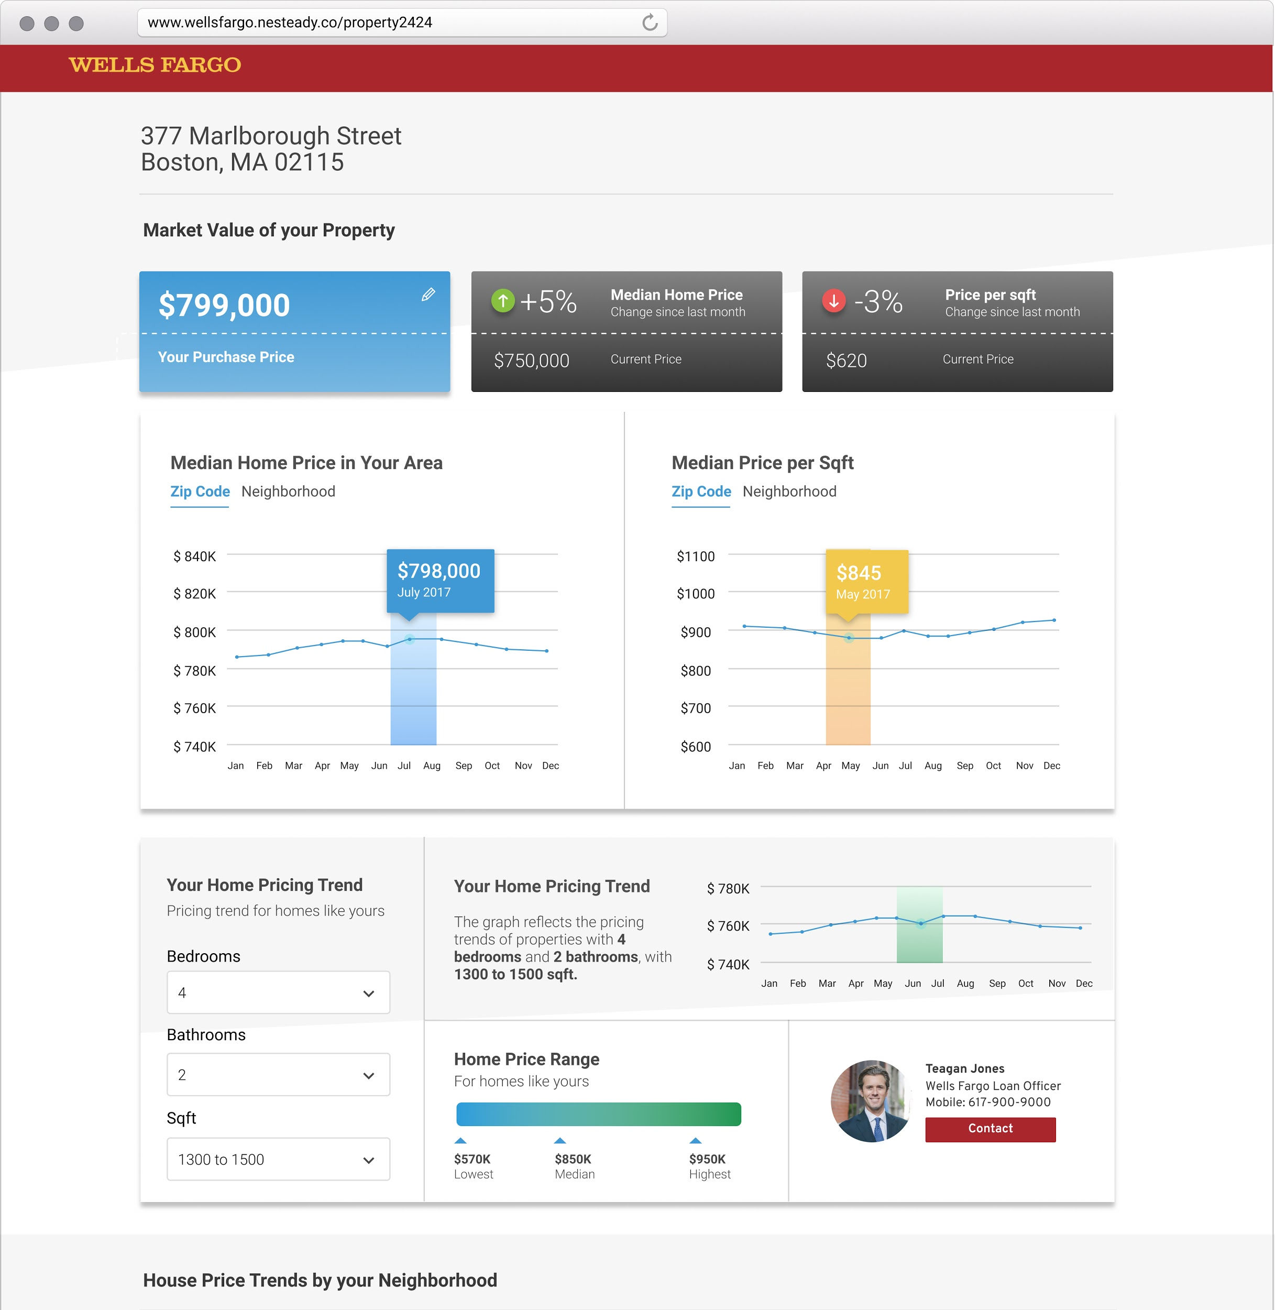

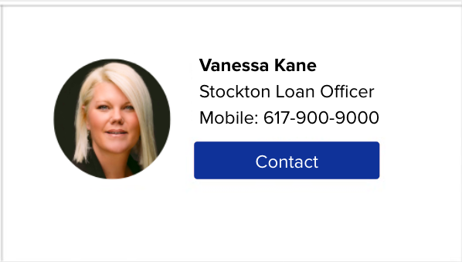
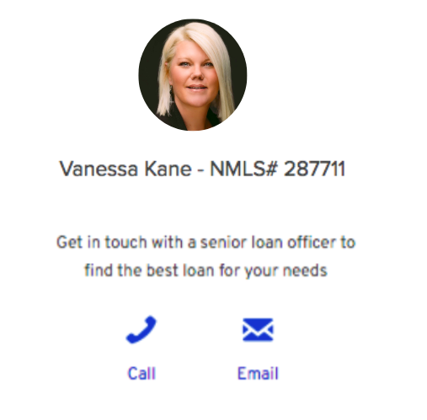
NestEngage
The ideal client retention solution
A responsive online page created for each property address the lender has financed in the past.
Extend your relationship with clients beyond the mortgage sale
Nurture refinance leads
Identify clients ready to sell, buy or renew their mortgage
Leverage HELOCs based on property value and engage with clients prior to renewals
Be the first lender to contact your own clients.
Get notified as soon as one of the properties you have financed goes on the market
www.stockton.nestready.co/property377marlborough
Vanessa Kane
Stockton Loan Officer
Mobile: 617-900-9000
Contact

Slide 15
Benefits
For CUs
Stronger relationship
Higher conversions
Customer retention
Cross-selling
For Members
Work with a trusted brand
Cash-reward on home
purchased
Superior user experience

Slide 16





Some of our clients
9th Largest Bank in North America
3rd Largest Credit Union in Canada
2nd Largest Credit Union in Ontario
Largest
Credit Union in Wisconsin
3rd Largest Credit Union in Manitoba

Slide 17


Thank You
Marcos Carvalho - CRO
marcos@nestreay.co

